Slide 1
PTI LOU for Manual Entry
If a PTI doesn’t have an “FT” number available, it will need to be entered manually. If this is the case, please forward PTI LOU to faculty@unm.edu and copy Shirley Rey.
Example:
Subject line of email: PTI LOU - Smith - Manual Entry – Math
Body of email: Hi there: The attached PTI LOU for Dr. Smith does not have an “FT” number and will need to be entered manually by your office. Thank you.

Slide 2
Email to OFAS for PTI LOU Manual Entry

Slide 3
Faculty teaching overload for manual entry
If a faculty doesn’t have a “T1” suffix available, it will need to be entered manually. If this is the case, please forward the teaching overload to faculty@unm.edu and copy Shirley Rey.
Example:
Subject line of email: Teaching overload-Johnson - Manual Entry – Sociology
Body of email: Hi there: The attached faculty teaching overload for Dr. Johnson does not have a “T1” suffix and will need to be entered manually by your office. Thank you.

Slide 4
Email to OFAS for Teaching Overload Manual Entry

Slide 5
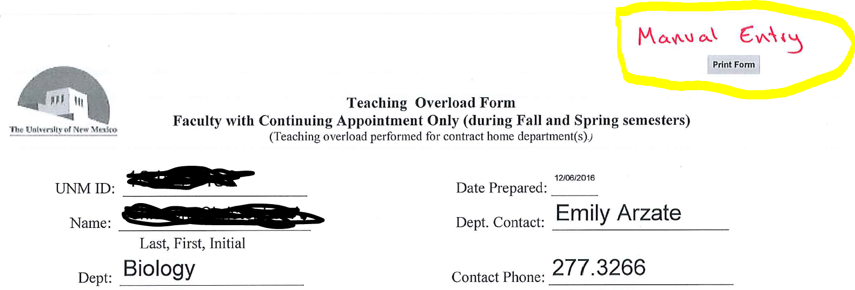
Manual Entry notation on copy of PTI LOU and Teaching Overloads
If you discover that the PTI LOU or Teaching Overload has to be entered manually by OFAS, please write “Manual Entry” on the upper right hand corner of the form.

